Slide 1
HIRURŠKI TRETMAN PACIJENATA SA PONOVLJENIM NEUSPEŠNIM POSTUPCIMA IVF
Doc. Dr sc. med Aleksandra Trninić Pjević
Klinički centar Vojvodine, Klinika za ginekologiju i akušerstvo, Zavod za Humanu reprodukciju

Slide 2
Neuspeh implantacije: molekularni mehanizmi i klinički tretman
Evaluacijom trenutnog znanja o mehanizmima neuspešnih implantacija kod različitih ginekoloških oboljenja,
procenom saznanja o endometrijalnoj prijemčivosti i
metodama lečenja za poboljšanje implantacije,
postoji potreba za optimizacijom endometrijuma u lečenju neplodnosti, što će poboljšati stopu uspeha IVF.

Slide 3
Neuspeh implantacije: molekularni mehanizmi i klinički tretman
Evaluacija markera implantacije može pomoći da se predvidi ishod trudnoće i detektuje skriveni defekt odgovaran za neuspešnu implantaciju.

Slide 4
Mehanizmi neuspešne implantacije u različitih ginekoloških oboljenja
Endometrioza
Hidrosalpinks
Miomi
Endometrijalni polipi
Adenomioza
PCO
Endometritis

Slide 5
Mehanizmi neuspešne implantacije u različitih ginekoloških oboljenja
Endometrioza
Niz molekularnih i genetskih anomalija na ednometrijumu žena sa endometriozom
Velik broj markera implantacije pokazuje patološku ekspresiju kod pacijenata sa endometriozom.
Diaz I, Fertil Steril 2000.
Lessey BA J Clin Endocrinol Metab 1994.
Dimitriadis E, J Reprod Immunol 2006.

Slide 6
Mehanizmi neuspešne implantacije u različitih ginekoloških oboljenja
Hidrosalpinks
sadržaj hidrosalpinksa ispira endometrijum inflamatornim agensima u vreme implantacije, a takođe i interferira sa apozicijom implantirajućeg embriona
Uočena je i smanjena ekspresija gena
Zeyneloglu HB. Fertil Steril 1998.
Camus E. Hum Reprod 1999.

Slide 7
Mehanizmi neuspešne implantacije u različitih ginekoloških oboljenja
Miomi

Slide 8
Miomi i neplodnost
Koja je veza izmedju fertilnisti i mioma?
Koji su mogući mehanizmi uticaja mioma na neplodnost?
Koja i kolika je korist i potreba za izvođenjem miomektomije?

Slide 9
Miomi i neplodnost
Veličina
Lokalizacija
Broj mioma
Tip
American Fertility Society. Guidelines for practice: myomas and reproductive dysfunction. 1992

Slide 10
Miomi i reproduktivni ishod
Teško je proceniti direktni uticaj mioma na neplodnost:
Odlaganjem radjanja miomi su češći sa uznapredovalim godinama žene:
Češći su kod IVF pacijenata

Slide 11
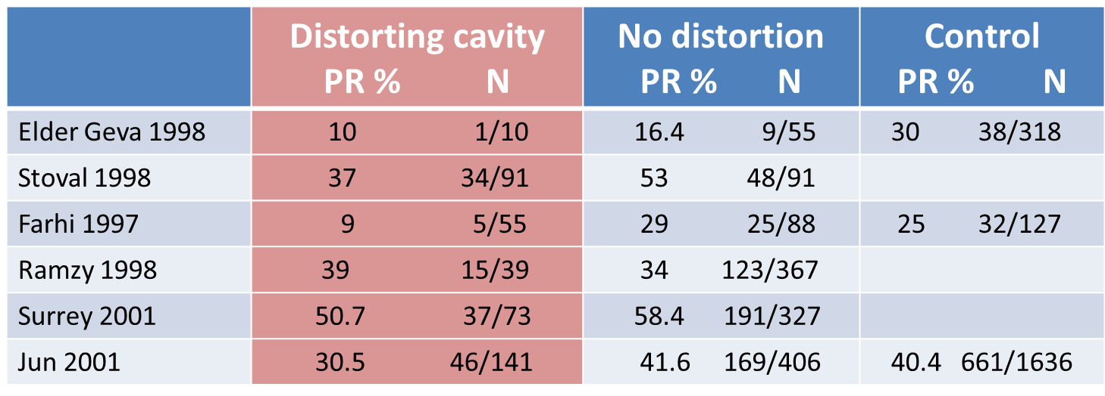
Postoji li povezanost izmedju mioma i neplodnosti?
Impact of myoma on fertility: Review
Donnez et al ,2004

Slide 12
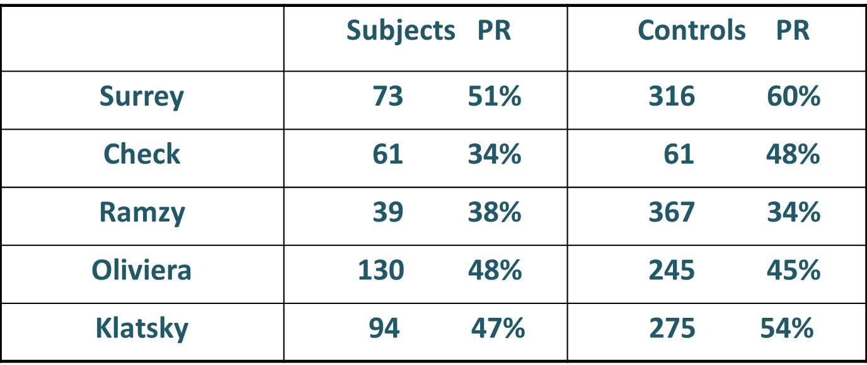
Intramural Leiomyoma
Pregnancy Rate after IVF

Slide 13
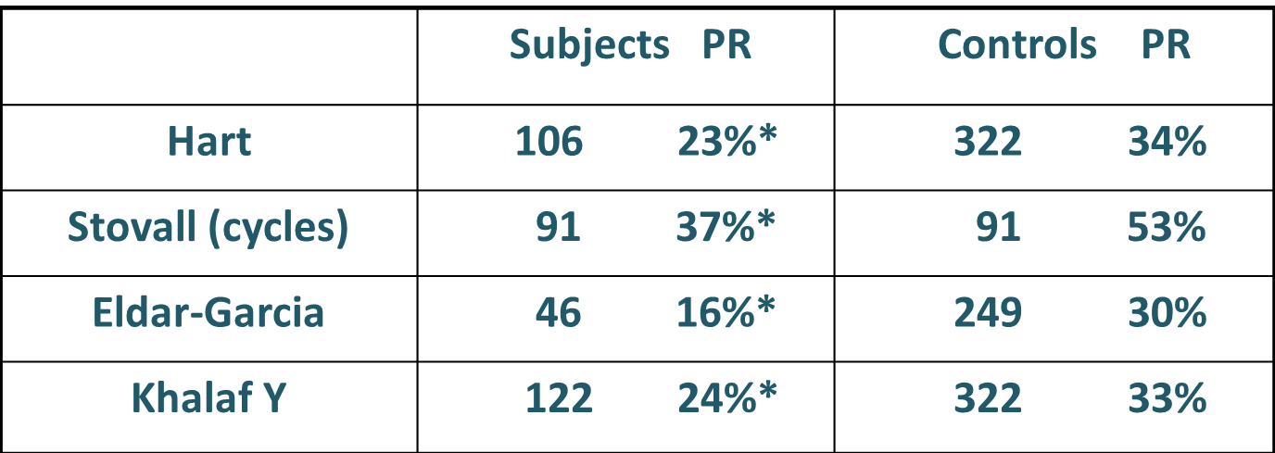
Intramural Leiomyoma
Pregnancy Rate after IVF

Slide 14
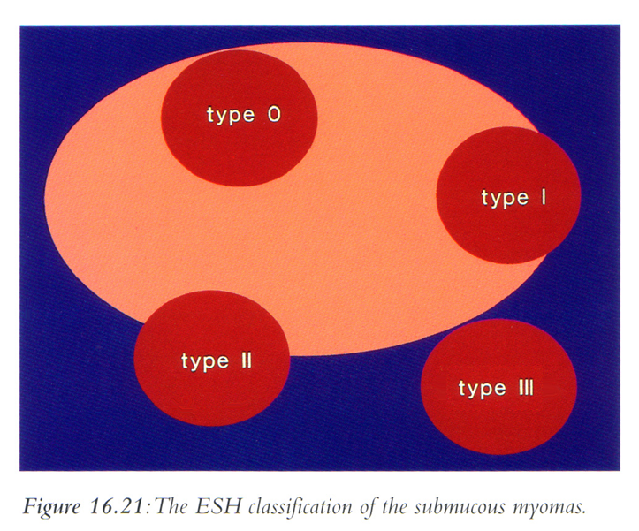
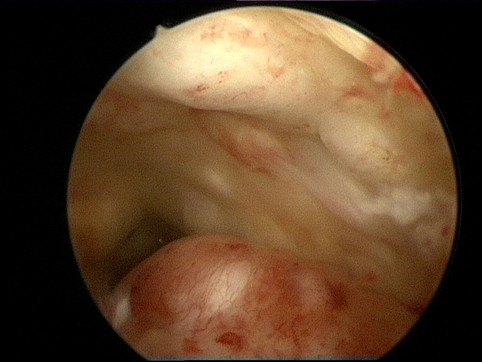
Submukozni miomi
Submucous myomas and their implications in the pregnancy rates of patients with otherwise unexplained primary infertility undergoing hysteroscopic myomectomy: a randomized matched control study
Shokeir T et al. Fertil Steril. 2010
Notes:
Hysteroscopic myomectomy for submucous fibroids in women with unexplained primary infertil- ity is effective in achieving a better pregnancy rate.

Slide 15
Myoma and Infertility: Review
(Pritts EA 2009 Fertil Steril 91, 4:1215-1223)
Subserosal fibroids do not affect fertiltiy or spontaneous
abortion rates
Submucosal fibroids lowers fertility rates and myomectomy
enhances rates of conception and live births
Intramural myoma with or without distortion of the uterine
cavity may cause a detrimental effect on conception and
reaching viability with pregnancy.
Effect of myomectomy is unclear.

Slide 16
Impact of Intramural Myomas on In Vitro Fertilization
The decision to proceed with myomectomy in an asymptomatic patient with unexplained infertility remains controversial. Current data suggest surgical treatment for patients who have uterine cavity distortion.
Sachev and Seifer. Infert. and Reprod. Clin, North Am. 2002

Slide 17
Effect of intramural myoma & IVF
Intramural fibroids negatively affects IVF results
Hart R et al 2001 Hum reprod 11: 2411-2417
Khalaf Y et al2006 Hum Reprod 10: 2640-2644
Intramural fibroids do not affect IVF results
Ng EH, Ha PC, 2002,Hum Reprod 3: 765-770
Oliveira Fg et al. 2004 Fertil Steril 81: 582-587
Klatsky Pc et al. 2007, Hum Reprod 2: 521-526

Slide 18
Effect of large intramural fibroids (>5 cm)
Hart R et al Hum Reprod 2001 16(11): 2411
Results of IVF where all significantly reduced:
Implantation rate dropped from 20.2 to 11.9 % (p=0.018)
Pregnancy rate dropped from 34.1 % to 23.3 % (p=0.016)
Ongoing pregnancy rate dropped from 28.3 to 15.1 % (p=0.003)
Large intramural myoma negatively affects pregnancy outcome
after IVF
Large intramural myomas should be removed before IVF

Slide 19
Intramural fibroids smaller than 5 cm
THE GREY ZONE
Da li ih treba zanemariti?
Da li ih treba operisati pre IVF?
Da li ih treba operisati posle neuspešnog IVF?
Posle koliko neuspešnih IVF postupaka ih operisati?
Da li ih uvek operisati?
Da li na odluku o operaciji utiče činjenica o vrsti finansiranja IVF procedure?

Slide 20
Influence of small intramural fibroids: cumulative outcome
(Khalaf et al Hum Reprod 2002)
 | Pregnancy rate | Ongoing PR | Live birth rate
Intramural < 5 cm | 23.6 % | 18.8 % | 14.8 %
Control | 32.9 % | 28.5 % | 24 %
(p < 0.05)

Slide 21
Uterine leiomyomas reduce the efficacy of assisted reproduction cycles: results of a matched follow-up study
Stovall et al. Hum reprod 1998, 13.
 | Fibroids | Controls | RR | CI
Nb | 91 | 91
Impl. rate | 13.8% | 19.7%
Clin Pr | 34.3% | 52.7% | 0.71 | 95% | 0.51-0.98
LBR | 33% | 48.4% | 0.68 | 95% | 0.47-0.98
No cavity deformation, no submucosal fibroids
Average size 28.7 X 19.7 mm
Notes:
Average size 28.7 X 19.7
No cavity deformation, no submucosal fibroids

Slide 22
The effect of intramural fibroids without uterine cavity involvement on the outcome of IVF treatment: a systematic review and meta-analysis
Sesh Kamal Sunkara1, Mohammed Khairy, Tarek El-Toukhy,Yacoub Khalaf, and Arri Coomarasamy
Human Reproduction, Vol.25, No.2 pp. 418–429, 2010

Slide 23
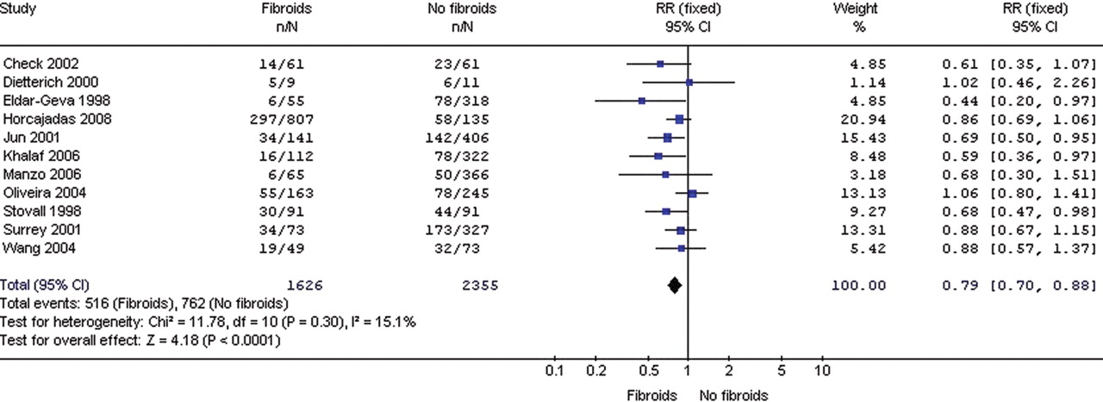

Forest plot of studies of non-cavity-distorting intramural fibroids versus no fibroids in women undergoing IVF treatment for outcome of live birth rates.
Sunkara S K et al. Hum. Reprod. 2010;25:418-429
© The Author 2009. Published by Oxford University Press on behalf of the European Society of Human Reproduction and Embryology. All rights reserved. For Permissions, please email: journals.permissions@oxfordjournals.org
Notes:
Forest plot of studies of non-cavity-distorting intramural fibroids versus no fibroids in women undergoing IVF treatment for outcome of live birth rates.

Slide 24
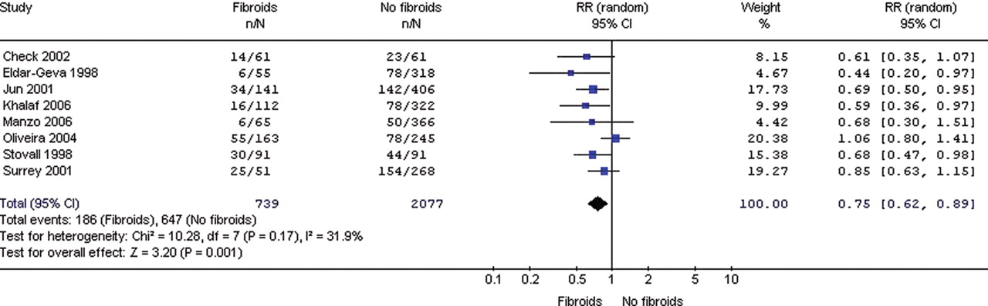
Forest plot of studies of non-cavity-distorting intramural fibroids versus no fibroids in women <37 years undergoing IVF treatment for outcome of live birth rates.
18% - 25% reduction in the clinical PR
Sunkara S K et al. Hum. Reprod. 2010;25:418-429
© The Author 2009. Published by Oxford University Press on behalf of the European Society of Human Reproduction and Embryology. All rights reserved. For Permissions, please email: journals.permissions@oxfordjournals.org
Notes:
Forest plot of studies of non-cavity-distorting intramural fibroids versus no fibroids in women <37 years undergoing IVF treatment for outcome of live birth rates.

Slide 25
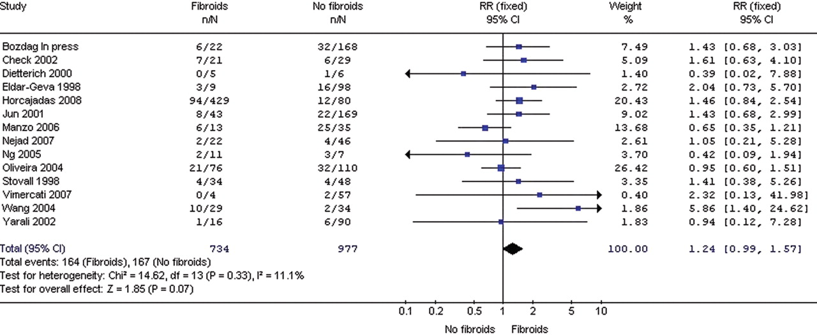
Forest plot of studies of non-cavity-distorting intramural fibroids versus no fibroids in women undergoing IVF treatment for outcome of miscarriage rates.
Sunkara S K et al. Hum. Reprod. 2010;25:418-429
© The Author 2009. Published by Oxford University Press on behalf of the European Society of Human Reproduction and Embryology. All rights reserved. For Permissions, please email: journals.permissions@oxfordjournals.org
Notes:
Forest plot of studies of non-cavity-distorting intramural fibroids versus no fibroids in women undergoing IVF treatment for outcome of miscarriage rates.
Reduction in pregn rate and LBR doesn’t mean that myomectomy will result in higher pregn rates in terms of spontaneous conception

Slide 26
Conclusion
This systematic review, which included 6087 IVF cycles, found that the presence of non-cavity distorting intramural fibroids on average reduces the live birth rate by 21% and the clinical PR by 15% per IVF cycle compared with no fibroids.
Sunkara S K et al. Hum. Reprod. 2010;25:418-421
Notes:
Forest plot of studies of non-cavity-distorting intramural fibroids versus no fibroids in women undergoing IVF treatment for outcome of miscarriage rates.
Reduction in pregn rate and LBR doesn’t mean that myomectomy will result in higher pregn rates in terms of spontaneous conception

Slide 27
Intramural fibroids smaller than 5 cm
Metwally et al. (RBM online) meta-analysis: no hard data to support the negative effect of intramural myoma upon pregnancy rates.

Slide 28
Infertilitet i miomi su kontroverzni jer je:
teško definisati kauzalnu vezu
pregledom prethodnih (70-80) studija utvrđena stopa
turdnoća od 50 % nakon miomektomije kod neplodnih
nedostatk dobrih kontrolisanih studija
nedostatak jasno definisane veličine, broja i lokalizacije
nema stanadardizovanih diagnostičkih postupaka
izloženo više različitih parametara ishoda
rezultati variriraju 10- 70 % (Donnez et al.)

Slide 29
Mogući mehanizmi delovanja mioma na neplodnost:
Remećenje i nepravilnost materične šupljine
Naslanjanje i okluzija tubarnih ostijuma
Remete normalne ritmične uterine kontrakcije
Izazivaju vaskularne promene
Smanjuju mogućnost implantacije
Abnormalna endometrijalna maturacija
Hunt J. 1974 Clin.Obstet.Gynecol.
Iosif C. 1983 Acta Obstet.Gynecol.Scand
Vercellini, P. 1992 Fertil Steril
Verkauf B fertil Steril 1992
Wallach, E.E. 1995 Obstet.Gynecol.Clin.N.Am.

Slide 30
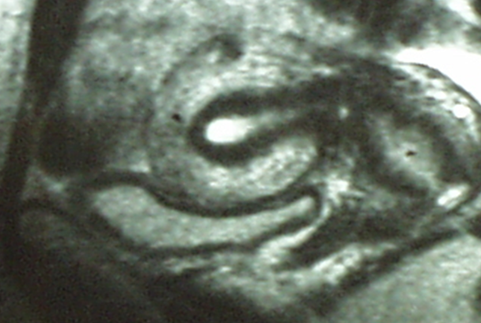
The Myometrial Junctional zone
JUNCTIONAL ZONA
Mala centralna zona pojačanog denziteta, važna za reprodukciju
Spoljni miometrijum
Deblja spoljna hipodenzna zona
Notes:
Miometrijum ima dva strukturno i funkcionalno različita entiteta.JZ: Functional important entity in reproduction- Ontogenetically related to endometrium
Cyclic changes in SSH receptors
Role in gamete transport and implantation
Junctional Zone Myometrium
Important role in Reproduction
Early changes from time of implantation
Decidualization and trophoblast invasion
Defective transformation of JZ spiral arteries in spectrum of pregnancy complications
Preterm rupture membranes
Preterm delivery
Early changes from time of implantation
Decidualization and trophoblast invasion
Defective transformation of JZ spiral arteries in spectrum of pregnancy complications
Preterm rupture membranes
Preterm delivery

Slide 31
Sličniji endometrijumu nego spoljnem miometrijumu
Kao i endometrijum, JZ je poreklomMullerovih kanala, a spoljnji miometrijum je ne-Mullerovog porekla (Noe, 1999.)
JZ a ne i spoljni miometrijum, podleže cikličnim promenama
Materična peristaltička aktivnost potiče ekskluzivno od JZ, dok je spoljni miometrijum miran tokom celog ciklusa

Slide 32
Decreased pregnancy rate is linked to abnormal
Uterine peristalsis caused by intramural fibroids
O. Yoshino, T. Hayashi et al. Hum Reprod 2010, 25: 3475-79.
Methods:
presence intramural fibroids, exclusion submucosal
no other fertility factors except endometriosis
regular menstrual cycles
cine MRI in luteal phase
Nb = 51
evaluation uterine peristalsis:
low peristalsis: 0 - 1 time /3min
high peristalsis: > 2 times /3min

Slide 33
Decreased pregnancy rate is linked to abnormal
Uterine peristalsis caused by intramural fibroids
O. Yoshino, T. Hayashi et al. Hum Reprod 2010, 25: 3475-79.
 | Low peristalsis | High peristalsis
Number | 29 (57%) | 22 (43%)
No endometriosis | 22 | 16
Yes endometriosis | 7 | 6
Nb fibroids | 2.8 ( 2.8) | 3.5 (+ 3.0)
Max. diam. | 53 ( 17) | 58 ( 21)
Deformation cav. | 15 | 10
No deformation cav. | 14 | 12
Pregnancy | 10 (34%) | 0 (0%)*
* P < 0.005
Notes:
(i) presence of intramural fibroids, excluding submucosal type; (ii) no other significant infertility factors (excluding endome- triosis); and (iii) regular menstrual cycles,
A higher frequency of uterine peristalsis during the mid-luteal phase might be one of the causes of infertility associated with intramural-type fibroids.

Slide 34
Effect of intramural myoma
A plausibel mechanism for intramural fibroids not distorting the cavity has been seen in a possible disruption of the junctional zone within the myometrial layer at the intial stages of embryo invasion and placentation.
(Horne AW, Critchley HO, Semin reprod Med, 2007,25: 483)

Slide 35
Differential infiltration of macrophages and prostaglandin production by different uterine leiomyomas
Seiyou Miura et al. Hum reprod 2006, 21
Besides cavity deformity, SMM nodules may also cause a strong and diffuse inflammatory reaction in the autologous endometrium.
(ii) Even when there is no cavity deformity, the presence of IMM nodule may also create an inflamed endometrium.
(iii) Endometria of control women and women with SSM display a minimal inflammatory change and may not have impaired fertility outcome. (iv) Surgical or medical treatments should be considered in infertile women who have sub- mucosal and/or intramural fibroids before resorting to ART.
.
L.I.F.E.
Leuven Institute for Fertility & Embryology

Slide 36
Leiomyomas may impair fertility through several mechanism:
mechanical factor (cavity deformation)
disturbed uterine peristalsis
alterations of the endometrium
inflammation
subcellular and molecular defects

Slide 37
Mehanizmi neuspešne implantacije u različitih ginekoloških oboljenja
Endometrijalni polipi
mehaničkim interferiranjem transporta spermatozoida,
implantaciojm embriona i
patološkom ekspresijom gena uključenih u implantaciju
Varasteh NN, Obstet Gynecol 1999.
Spiewankiewicz B. Clin Exp Obstet Gynecol 2003.
Shokeir TA. J Obstet Gynaecol Res 2004.

Slide 38
Mehanizmi neuspešne implantacije u različitih ginekoloških oboljenja
Adenomioza
adenomioza javlja kada se normalna granica izmedju sloja bazalnog endometrijuma i miometrijuma naruši
značaj zapaženih morfoloških, biohemijskih i molekularnih anomalija je nejasan ali se smatra da utiče na fertilnost i ishod IVF postupaka

Slide 39
Mehanizmi neuspešne implantacije u različitih ginekoloških oboljenja
Adenomioza
poremećaj JZ sa posledičnom patološkom uterinom peristaltikom
Campo S. Reprod Biomed Online, 2012.
Caterina Exacoustos. AJOG, 2013.

Slide 40
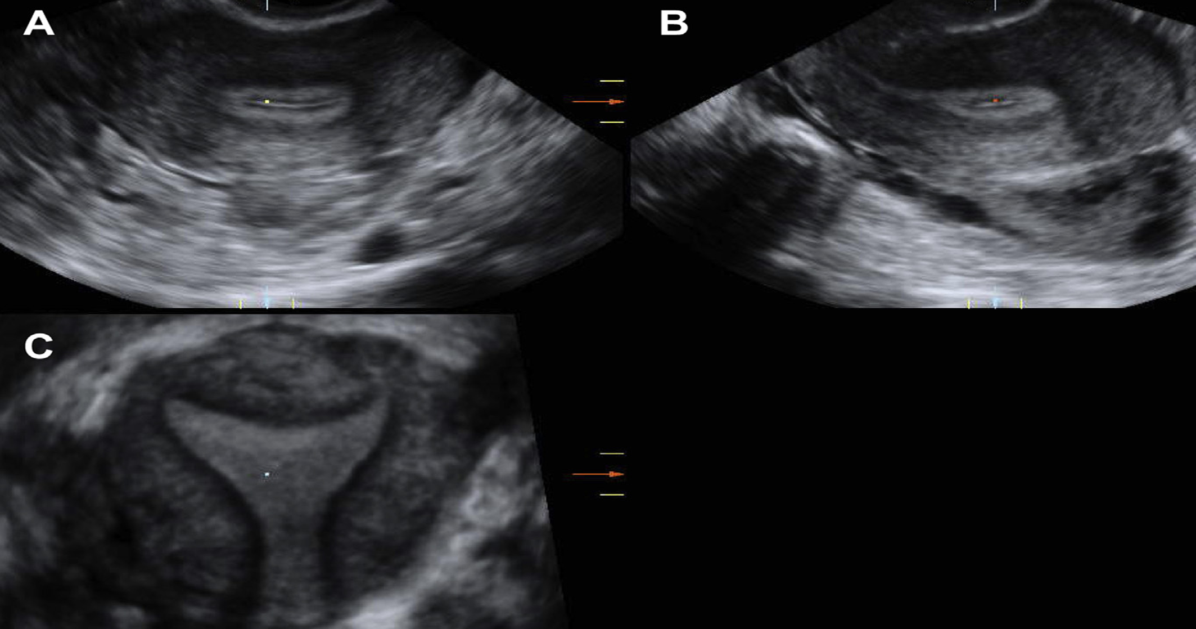

Slide 43
Mehanizmi neuspešne implantacije u različitih ginekoloških oboljenja
PCO
Postoje dokazi o poremećaju ekspresije markera uterine receptivnosti na endometrijum.
smanjena ekspresija markera uterine receptivnosti i poremećaj regulacije receptora steroidne ekspresije zajedno doprinose nižim stopama trudnoće kod žena sa PCO sindromom
Endometritis

Slide 44
Klinička procena endometrijuma
Ultrazvučno merenje
Senzitivnije imidžing tehnike, 2D i 3D UZ, MRI
Kriterijumi za definisanje adenomioze na MRI su:
Miometralna masa sa nejasnim granicama, niskog intenziteta;
Difuzno ili lokalno širenje JZ (juncionalne zone);
JZ deblja od 12-15mm;
Slabo definisana lezija u JZ;
Mala hipointenzivne miometralne nakupine

Slide 45
Postupci u kliničkoj praksi kojima bi se poboljšala implantacija
Treman endometrioze je veoma individualan, pogotovo nakon neuspešnih ranijih IVF postupaka
Dugi protokol i pretreman GnRH – agonistima pre IVF Druga opcija je uklanjanje endometriotičnih lezija ablativnim tehnikama

Slide 46
Miomektomija: da ili ne?
Submukozni miomi
Dobro i ubedljivo dokazano da miomektomiju treba sprovesti pre IVF
Intramuralni miomi:
> od 5cm
Operisati pre IVF
<od 5cm
Prema različitim autorima PR se rezlikuje- nedostaje homegeno ujednačeno mišljenje

Slide 47
Postupci u kliničkoj praksi kojima bi se poboljšala implantacija
Treman adenomioze:
Hirurški- totalna ili parcijalna op
(nodularni, cistični, sklerotični i difuzni oblik)
Dugi protokol i pretreman GnRH – agonistima pre IVF
IUD sa gestagenima

Slide 48
HISTEROSKOPIJA ?

Slide 49
Postoje pouzdani dokazi da histeroskopska hirurgija poboljšava ishod IVF
I DALJE ZVANIČNO VAŽI:
Hysteroscopy is accomplished to confirm suspected uterine abnormalities and as appropriate therapy
ESHRE Capri work shop group. Optimal use of infertility diagnostic test and treatments. Hum Report 2000;15:723–732.
NICE, 2004; 2012.
or in infertile patients after repeated in vitro fertilization-embryo transfer (IVF-ET) failure
Dicker D, Aschenazi J, Feldberg and al, 1992
Balmaceda JP, Ciuffardi I, 1995
Oliveia FG and al, 2003
Demirol A and Gurgan T,

Slide 50
Histeroskopija pre prvog postupka IVF:
38% vs. 18% PR ( Histeroskopska vs. Ne histeroskopska grupa)
N Doldi, P Persico, F Di Sebastiano and al, 2005
38% IVF pacijenata ima patologiju kavuma
MD Hinckley, AA Milki, 2004
45% ima patološki nalaz i endometritis, polipi, miomi su najčešći
J Feghali, J Bakar, JM Maynga and al, 2003
OH pre prvog ili sledstvenog IVF postupka udvostručuje stopu kliničkih trudnoća; OR= 2.01
El-Toukhy et al.2008

Slide 51
Histeroskopski tretman submukoznih mioma poboljšava ishod IVF postupaka (OR do 1,9)
Bosteels J. Et al.2010
Somigliana E.et al.2007
Histeroskopski tretman uterinih anomalija (septum) dovodi do izjednačavanja stopa trudnoća ovih pacijenata sa pacijentima bez ove patologije
Ozgur K. et al, 2007

Slide 52
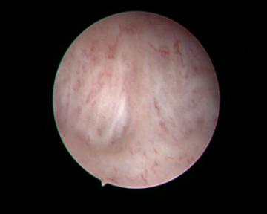
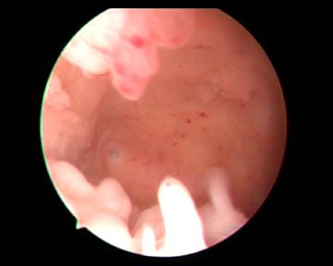
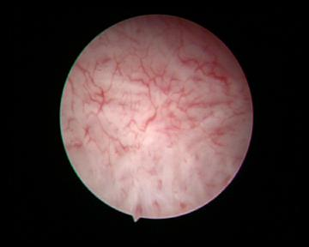
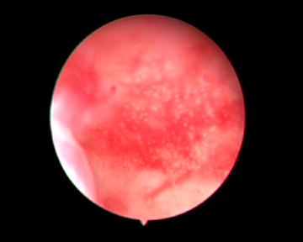
Suptilne lezije endometrijuma kao što su:
-hiperplazija
-hronični endometrtis
-mikropolipoza,
-”strawberry-like “ endometrium
-fibrozne trake
-hipervascularizacija
Notes:
Apart from the basic pathological findings hysteroscopy is furthermore useful in the detection of intrauterine adhesions, endometrial changes such as hyperplasia or chronic endometriosis, all of which are well-known factors of not only sterility but also unsuccessful IVF cycles.

Slide 53
Postoje pouzdani dokazi da histeroskopska hirurgija poboljšava ishod IVF
MEHANIZMI DELOVANJA HISTEROSKOPIJE NA ISHOD ivf:
1. LEČENJEM INTRAUTERINE PATOLOGIJE
Submukozni miomi
Endometrijalni polipi
Kongenitalne uterine anomalije
Hidrosalpinksi
Suptilne lezije endometrijuma
2. OLAKŠAVA ET
3. Histeroskopska „trauma“ endometrijuma tokom lutealne faze ciklusa koji predhodi IVF ciklusu udvostručava stopu trudnoća

Slide 54
ZAKLJUČAK
Stope trudnoća, nakon postupaka vantelesne opodnje, mogu značajno da se poboljšaju tretmanom intrauterine patologije i patologije cervikalnog kanala, kao i tretmanom svih patološki stanja reproduktivnih organa

Slide 55
ZAKLJUČAK
pažljiva evaluacija svih organa – jajovoda, jajnika i materice je neophodna.
JZ pregled- rutinski

Slide 56
Indikovanje laparoskopije i histeroskopije, ciljano, radi uklanjanja patologije reproduktivnih organa, ponekad deluje kao korak unazad, nakon ponavljanih IVF procedura, ali je u suštini preduslov za uspešan ishod.

Slide 57
Svako patološko stanje menja receptivnost endometrijuma izmenom ekspresije gena odgovorinih za implantaciju i lečenjenjem patologje na bilo kom od organa, menja receptivnost na bolje
Sve više se insitira da nema steriliteta nepoznatog uzroka, već samo da je on neotkriven.

Slide 58
Najbolje stope trudnoća ostvaruju se kod pacijentkinja sa histeroskopski verifikovano urednim nalazom kavuma, ali i lečenjem patologije kavuma.

Slide 59


Pogrešno interpretirane i zaboravljene, velike istine se kriju u nama, ako se samo usudimo da bolje pogledamo…..
Antoine de Saint-Exupéry

